Slide 1
Advanced Java Concepts - Assignments I
BY: Rishika Kumari
1852

Slide 2
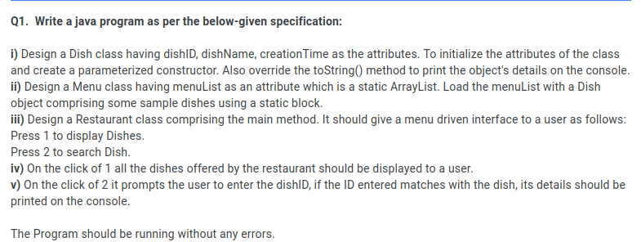

Slide 3
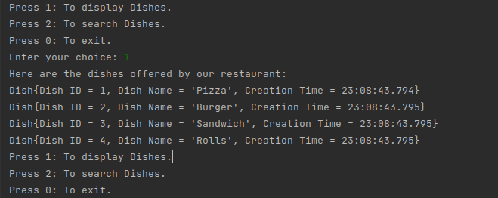
Outputs: Showing number of dishes.

Slide 4
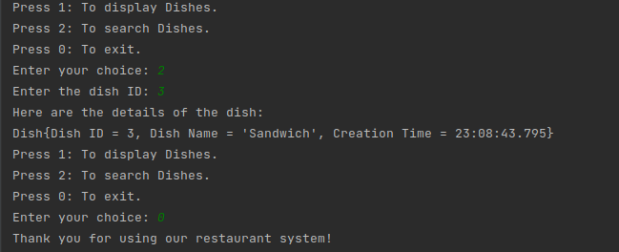
Outputs: Searching operation on dishes through dish Ids.

Slide 5
THANK YOU!

